Slide 1
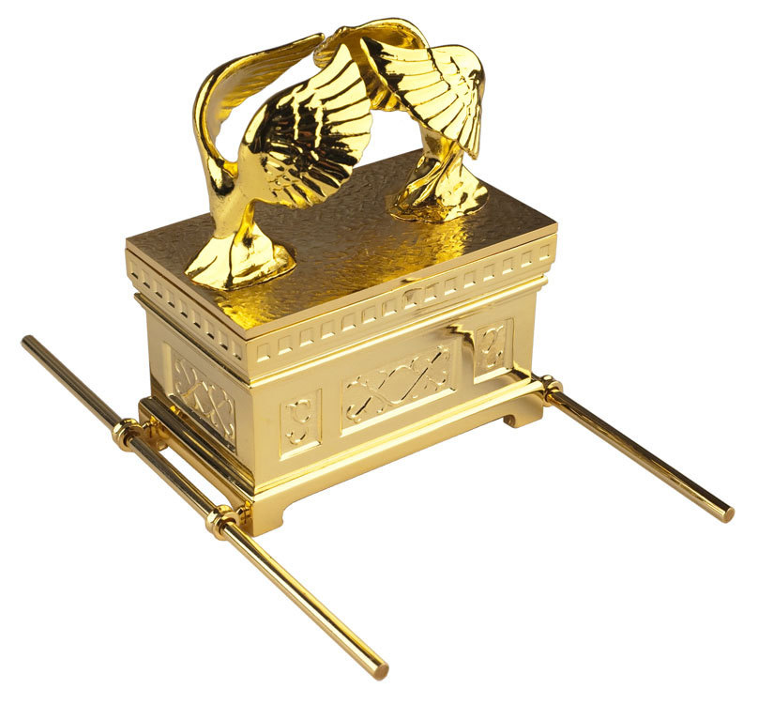
Pekudei
Exodus 38:21 – 40:38

Slide 2
SHEMOT 38:21
Eleh pekudei ha-mishkan, mishkan ha-aydut, asher pukad ahl-pi Mosheh, ahbudat ha-Levoim, beyad a-Yitamar ben Aharon ha-koheen.
These were the accounts of the Tabernacle, the Tabernacle of the Witness, which was accounted for by the command of Mosheh, for the service of the Levites, by the hand of Ithamar son of Aharon the priest.

Slide 3
Outline
• Everything was made according to the instructions.
• Totals of how much gold, silver and bronze was used.
• The commands to put it all together, in a certain order.
• The account of them putting it all together, in order.
• YHVH inhabiting the new tabernacle.

Slide 4
Outline
• Everything was made according to the instructions.
• Totals of how much gold, silver and bronze was used.
• The commands to put it all together, in a certain order.
• The account of them putting it all together, in order.
• YHVH inhabiting the new tabernacle.
Exodus 40:17-33

Slide 5
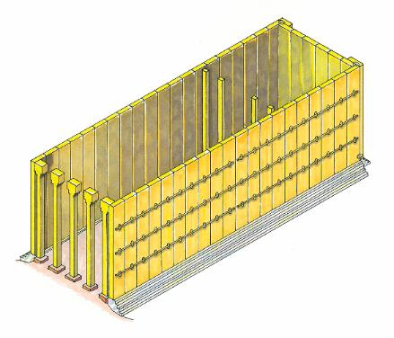
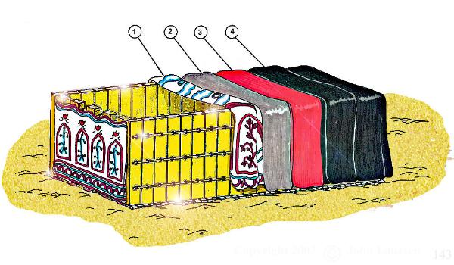
The MOST HOLY PLACE
The Tabernacle sockets, boards, bars and columns,
and then the tents/coverings on the top

Slide 6
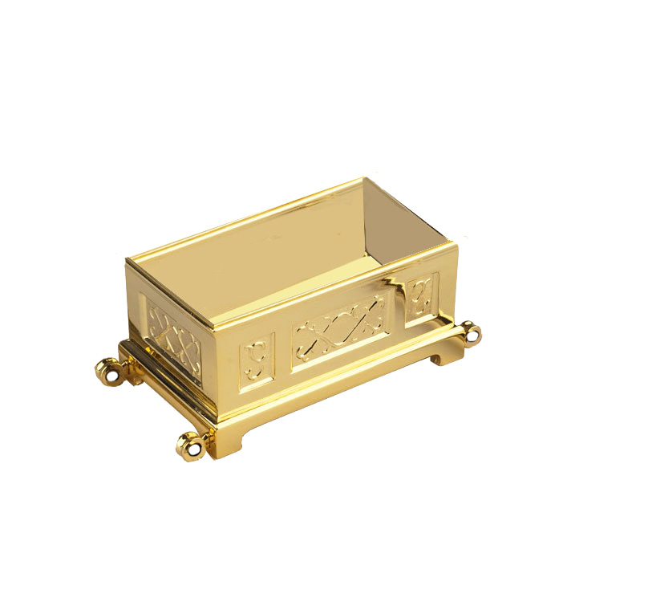
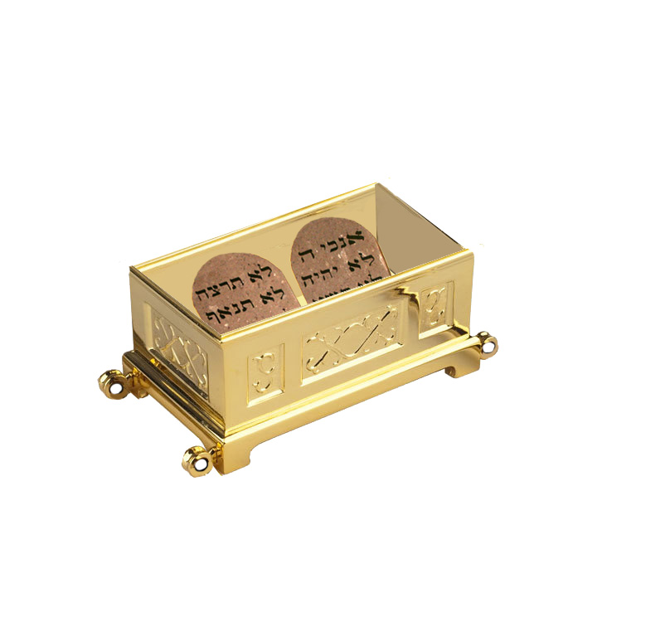
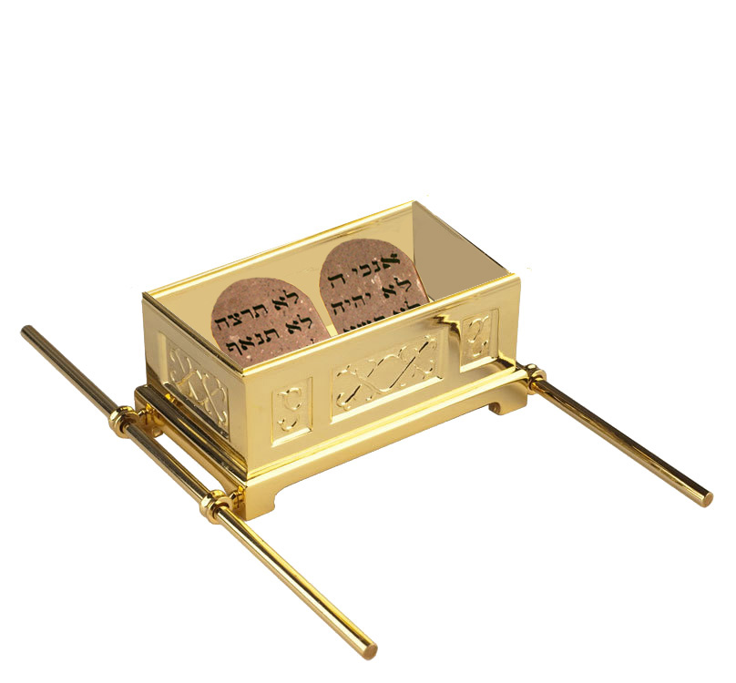
The MOST HOLY PLACE
The Witness placed in the Ark,
then the poles through the rings,
and then the mercy seat on top.

Slide 7
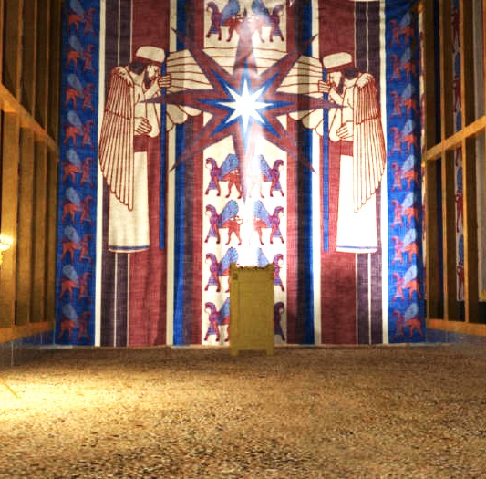
The MOST HOLY PLACE
The Ark was brought in.
The Veil - “to screen off the ark of the testimony”

Slide 8
THE HOLY PLACE
The Table, the utensils, and the bread “in order”
The Lampstand, “opposite the table,” LIT the lamps
The “Gold Altar,” and burned incense on it
The “Covering” (Door) to the Holy Place

Slide 9
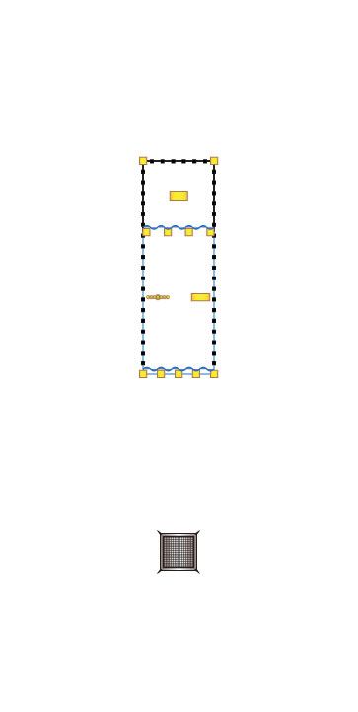
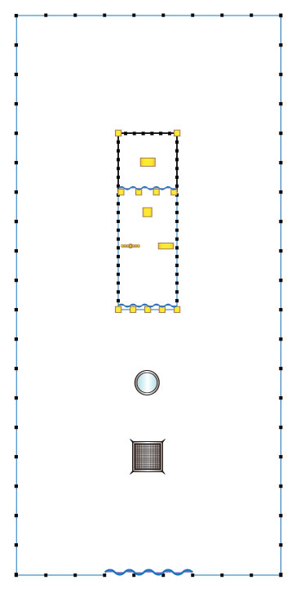
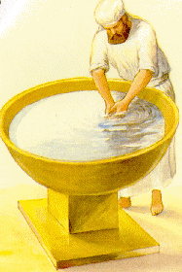
The Courtyard
The Bronze Altar, with burnt offerings, grain offerings
The Bronze Basin, “between” the Dwelling Place and the altar.
The Courtyard, “around” the Tabernacle
The Covering/“Gate” of the Courtyard

Slide 10
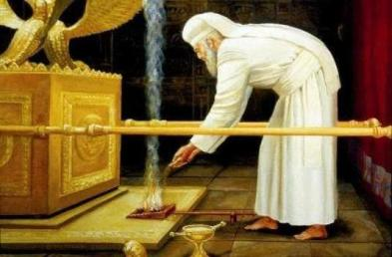
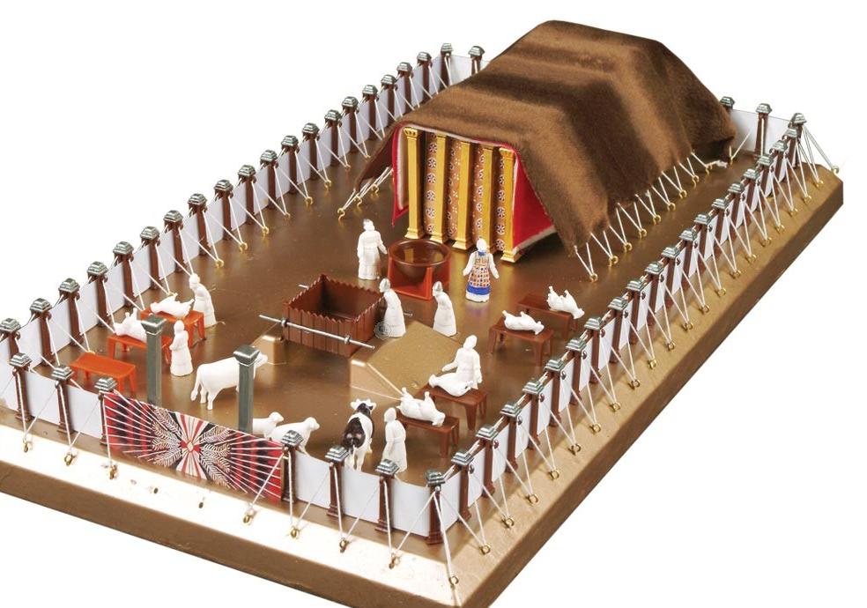
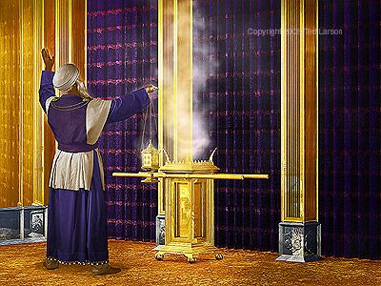
Three “DOORS”

Slide 11
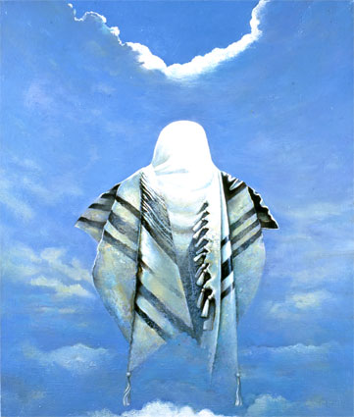
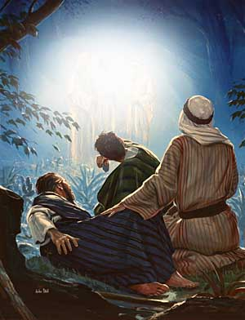
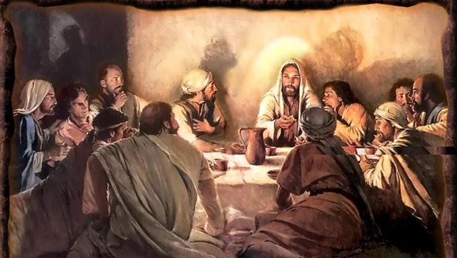
THREE “DOORS”

Slide 12
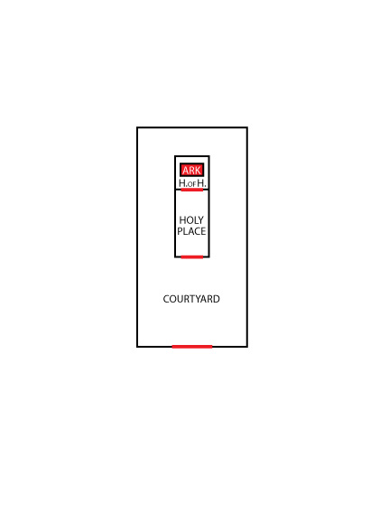
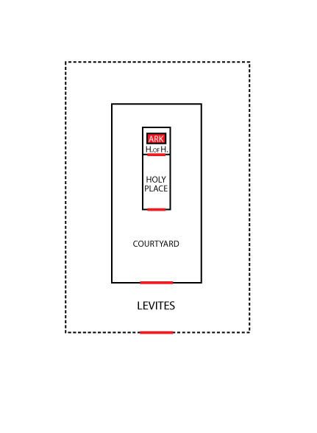
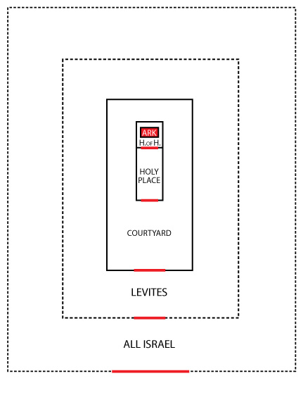
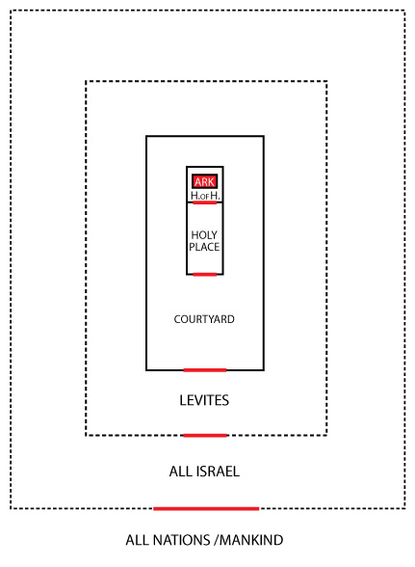
Actually SEVEN “LEVELS”
The Ark itself
only for the WORD w/YHVH
The Holy of Holies
only for the High Priest
The Tabernacle
only for the sons of Aaron
The Courtyard
only for trained priests
The Levitical camp
only for Levites
The camps of All Israel
only for Israelites
The Nations outside

Slide 13
YESHUA’s SEVEN LEVELS
Yeshua, the Word (King)
Yeshua, The High Priest (Lamb)
James, Peter, & John, brothers, family, inner circle
The Disciples, the 12, 70… chosen, taught, workers, sent
The Followers, the 5000, their families
ALL Israel, 12 Tribes, Past, present, & future
Those Outside, “goats,” awaiting the judgment

Slide 14
COMING OUT OF THE NATIONS
“FEAR Elohim and HONOR Him.... And WORSHIP Him who made the heaven and the earth, and sea, and fountains of water.”
Joining the spiritual nation of ISRAEL:
“The Eternal Good News” (Rev. 14:6-7)
The 10 Commandments – No other gods! Shabbat, etc.
The Feasts - “forever” commands – the Passover…
Torah / Messiah
Spiritual LEVITES – Separated, HIS. chosen, annointed, gifts
Join the PRIESTS – Be Trained, a disciple, worker, servant
The “Inner Circle” – Do His will, “family,” teach, shepherd…
The High Priesthood? – Interceder, Sacrificial? In with YHVH? Personifying HIS WORD?… That’s can only be YESHUA!
Right?...

Slide 15
We ARE THE BODY OF MESSIAH!
WE are the spiritual TABERNACLE, not made with hands!
WE are the ARK, containing the Word of YHVH!
WE are the TABLE of BREAD to the poor, the naked, the sick...
WE are the LIGHT shining Joy, Peace, and Truth in the darkness
WE are the CHILDREN of GOD!
WE are the PRIESTS working, serving in His congregation
WE are HIS FAMILY keeping the Torah, doing His will
WE are the DOOR to the nations, even FISHERS of MEN
WE are the TEACHERS that answer their questions
WE are the DISCIPLERS that walk by their side
WE are the INTERCESSORS that stand in the gap
WE ARE HIS BODY! The WORD made FLESH!

Slide 16
Pekudei
Exodus 38:21 – 40:38

