Slide 1
Sight of Our Eyes 1

Slide 2
Matthew (Mateo) 6:21-23 "For where your treasure is, there your heart will be also. The lamp of the body is the eye. If therefore your eye is good, your whole body will be full of light. But if your eye is bad, your whole body will be full of darkness. If therefore the light that is in you is darkness, how great [is] that darkness!”

Slide 3
Numbers (Numeros) 8:1-3 And YHVH spoke to Moses, saying: "Speak to Aaron, and say to him, 'When you arrange the lamps, the seven lamps shall give light in front of the lampstand.' " And Aaron did so; he arranged the lamps to face toward the front of the lampstand, as YHVH commanded Moses.

Slide 5
Why is it important?
What does YHVH and the enemy know?

Slide 6
1 John (Juan) 2:15-17 Do not love the world or the things in the world. If anyone loves the world, the love of the Father is not in him. For all that [is] in the world--the lust of the flesh, the lust of the eyes, and the pride of life--is not of the Father but is of the world. And the world is passing away, and the lust of it; but he who does the will of Elohim abides forever.

Slide 7
Ecclesiastes (Eclesiastes) 11:9 Rejoice, O young man, in your youth, And let your heart cheer you in the days of your youth; Walk in the ways of your heart, and in the sight of your eyes; but know that for all these God will bring you into judgment.

Slide 8
Jeremiah (Jeremias) 17:9-10 "The heart [is] deceitful above all [things], And desperately wicked; Who can know it? I, YHVH, search the heart, [I] test the mind, Even to give every man according to his ways, According to the fruit of his doings.”

Slide 9
Proverbs (Proverbios) 27:19-20 As in water face [reflects] face, so a man's heart [reveals] the man. Grave and Destruction are never full; so the eyes of man are never satisfied.

Slide 10
Jeremiah (Jeremias) 22:17 "Yet your eyes and your heart [are] for nothing but your covetousness, For shedding innocent blood, And practicing oppression and violence.”

Slide 11
Deuteronomy (Deuteronomio) 12:8 "You shall not at all do as we are doing here today--every man doing whatever [is] right in his own eyes—” (Perspective of RIGHT vs. WRONG) Example?

Slide 12
Genesis 3:1-3 Now the serpent was more cunning than any beast of the field which YHVH Elohim had made. And he said to the woman, "Has Elohim indeed said, 'You shall not eat of every tree of the garden'?” And the woman said to the serpent, "We may eat the fruit of the trees of the garden; but of the fruit of the tree which [is] in the midst of the garden, Elohim has said, 'You shall not eat it, nor shall you touch it, lest you die.' ”

Slide 13
Genesis 3:4-5 Then the serpent said to the woman, "You will not surely die. For Elohim knows that in the day you eat of it your eyes will be opened, and you will be like Elohim, knowing good and evil."

Slide 14
Who are we listening to?
How are we listening? (Shema)

Slide 15
2 Peter (Pedro) 2:1-2 But there were also false prophets among the people, even as there will be false teachers among you, who will secretly bring in destructive heresies, even denying YHVH who bought them, [and] bring on themselves swift destruction. And many will follow their destructive ways, because of whom the way of truth will be blasphemed.

Slide 16
2 Peter (Pedro) 2:3 By covetousness they will exploit you with deceptive words; for a long time their judgment has not been idle, and their destruction does not slumber.

Slide 17
2 Peter (Pedro) 2:9-10 [Then] YHVH knows how to deliver the Godly out of temptations and to reserve the unjust under punishment for the day of judgment, and especially those who walk according to the flesh in the lust of uncleanness and despise authority. [They are] presumptuous, self-willed. They are not afraid to speak evil of dignitaries (Authorities.)

Slide 18
2 Peter (Pedro) 2:15-16 Having eyes full of adultery and that cannot cease from sin, enticing unstable souls. They have a heart trained in covetous practices, [and are] accursed children. They have forsaken the right way and gone astray, following the way of Balaam the [son] of Beor, who loved the wages of unrighteousness…

Slide 19
2 Peter (Pedro) 2:18 For when they speak great swelling [words] of emptiness, they allure through the lusts of the flesh, through lewdness, the ones who have actually escaped from those who live in error.

Slide 20
2 Peter (Pedro) 2:19-20 While they promise them liberty (from authority-lies), they themselves are slaves of corruption; for by whom a person is overcome, by him also he is brought into bondage. For if, after they have escaped the pollutions of the world through the knowledge of YHVH and Savior Yeshua Messiah, they are again entangled in them and overcome, the latter end is worse for them than the beginning.

Slide 21
2 Peter (Pedro) 2:21 For it would have been better for them not to have known the way of righteousness, than having known [it], to turn from the holy commandment delivered to them.

Slide 22
Matthew (Mateo) 16:22-23 Then Peter took him aside and began to rebuke him, saying, "Far be it from You, Lord (Rabbi); this shall not happen to You!" But he turned and said to Peter, "Get behind Me, Satan! You are an offense to me, for you are not mindful of the things of Elohim, but the things of men."

Slide 23
Matthew (Mateo) 10:24-25 "The student is not above the teacher, nor a servant above his master. It is enough for students to be like their teachers, and servants like their masters. If the head of the house has been called Beelzebul, how much more the members of his household!”

Slide 24
Proverbs (Proverbios) 18:20-21 A man's stomach shall be satisfied from the fruit of his mouth; [From] the produce of his lips he shall be filled. Death and life [are] in the power of the tongue, and those who love it will eat its fruit.

Slide 25
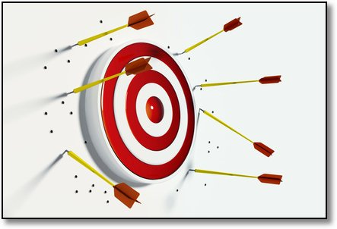
What is Sin?

Slide 26
10 Commandments
I am YHVH that saved you!!!
Do not make an idol or serve (worship) any other elohim.
Do not take His name (authority) in vain.
You shall Observe His Holy Shabbat. (Don’t work)
Honor your Father and Mother.
You shall not murder.
You shall not commit adultery.
You shall not steal.
You shall not bear false witness.
You shall not covet.

Slide 27
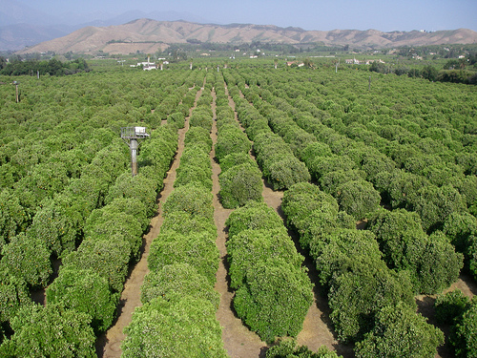
"We may eat the fruit of the trees of the garden; but of the fruit of the tree which [is] in the midst of the garden, Elohim has said, 'You shall not eat it, nor shall you touch it, lest you die.'

Slide 28
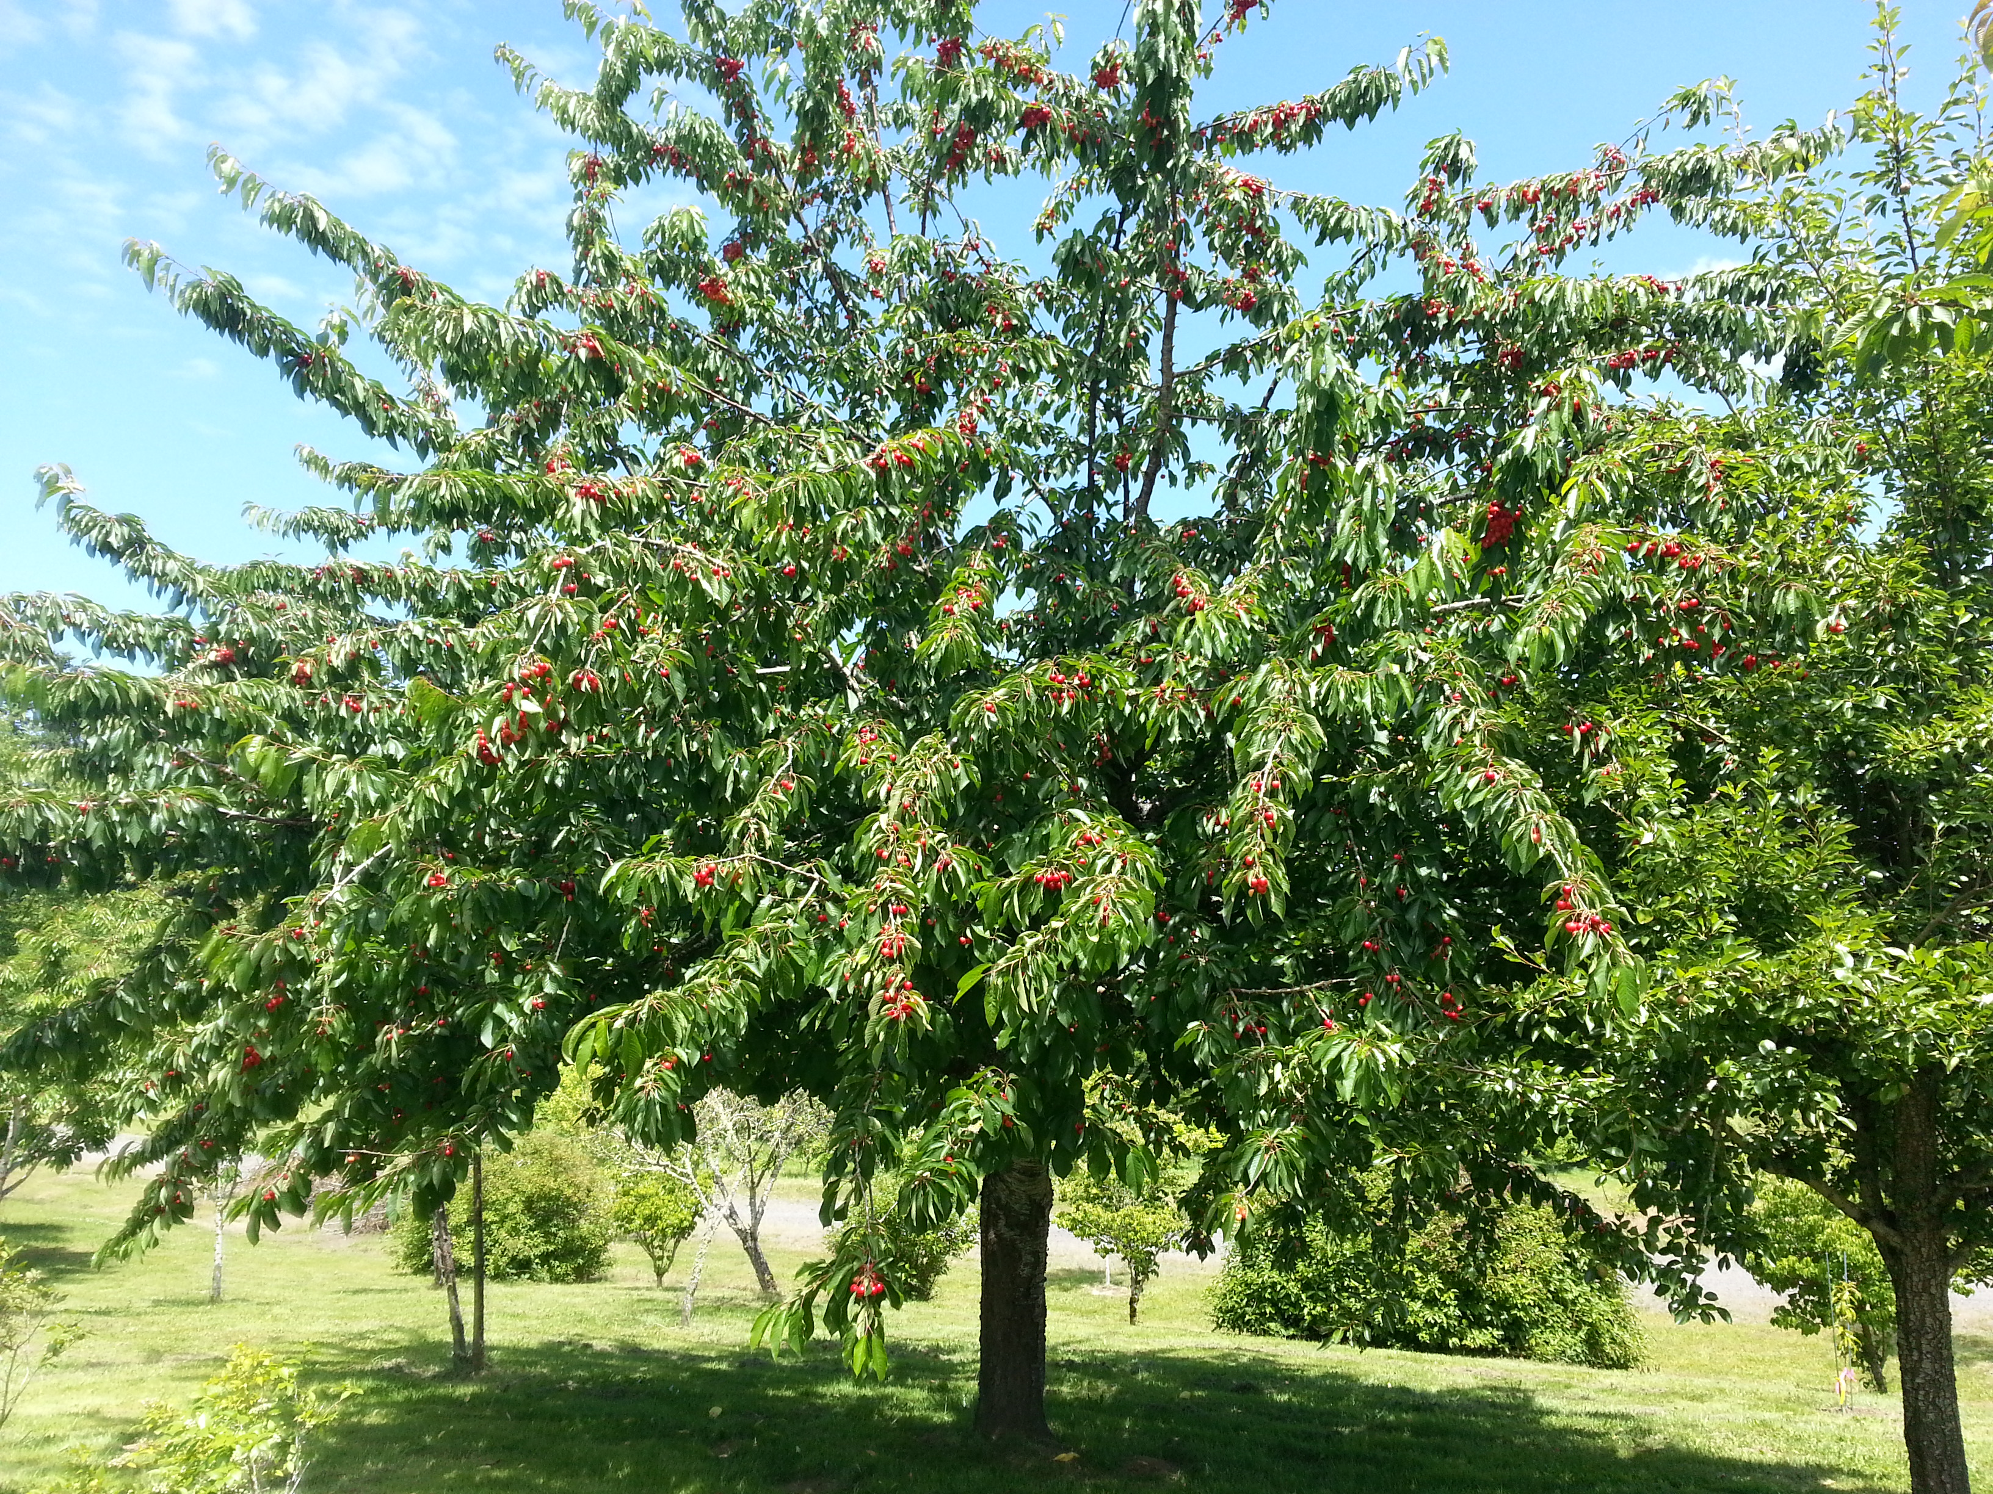
Curiosity

Slide 29
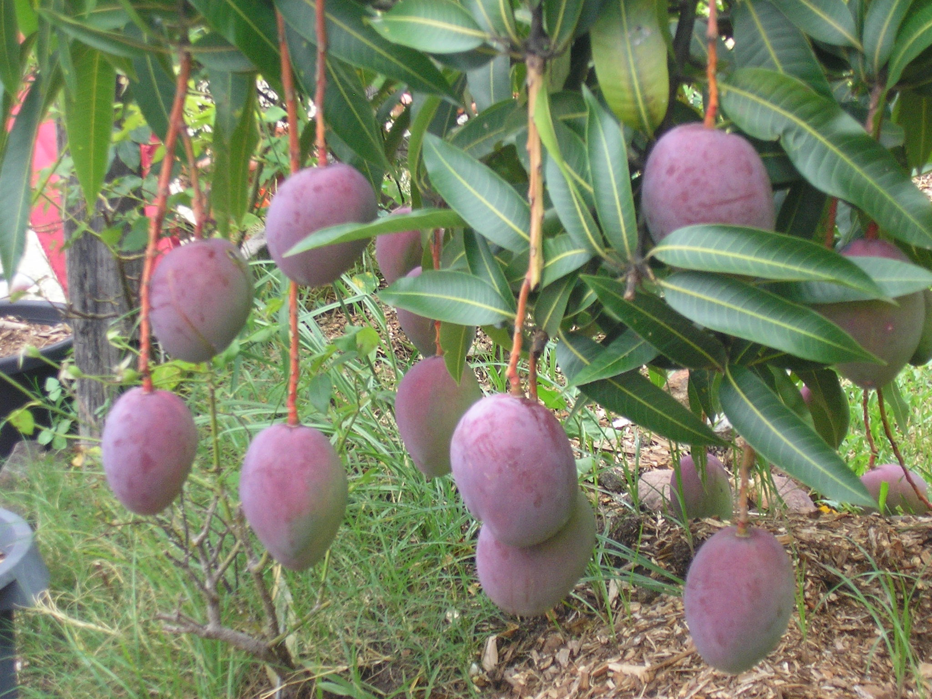
Close enough to touch-taste!!

Slide 30
Change in perspective

Slide 31
Change in perspective
The World

Slide 32
Breaking Torah
Torah of the World (Self)
Torah

Slide 33
Torah
Breaking Torah

Slide 34
Breaking Torah
Torah

Slide 35
False Testimony
Murder
Adultery
Stealing

Slide 36
Genesis 13:10-11 Lot looked around and saw that the whole plain of the Jordan toward Zoar was well watered, like the garden of YHVH, like the land of Egypt. (This was before YHVH destroyed Sodom and Gomorrah.) So Lot chose for himself the whole plain of the Jordan and set out toward the east. The two men parted company: (left the way of Abraham)

Slide 37
Genesis 39:7 And it came to pass after these things that his master's wife cast longing eyes on Joseph, and she said, "Lie with me."

Slide 38
Genesis 3:6 So when the woman saw that the tree [was] good for food, that it [was] pleasant to the eyes, and a tree desirable to make [one] wise, she took of its fruit and ate. She also gave to her husband with her, and he ate. (He saw her and believed the lie. If she can do it with no punishment- Many make it right.)

Slide 39
Romans (Romanos) 7:7-8 What shall we say then? [Is] the law sin? Certainly not! On the contrary, I would not have known sin except through the law. For I would not have known covetousness unless the law had said, "You shall not covet." But sin, taking opportunity by the commandment, produced in me all [manner of evil] desire. For apart from the law sin [was] dead.

Slide 40
Romans (Romanos) 7:11-12 For sin, taking occasion by the commandment, deceived me, and by it killed [me]. Therefore the law [is] holy, and the commandment holy and just and good.

Slide 41
Romans (Romanos) 7:14-15 For we know that the law is spiritual, but I am carnal, sold under sin. For what I am doing, I do not understand. For what I will to do, that I do not practice; but what I hate, that I do.

Slide 42
Romans (Romanos) 7:16-17 If, then, I do what I will not to do, I agree with the law that [it is] good. But now, [it is] no longer I who do it, but sin that dwells in me.

Slide 43
Romans (Romanos) 7:18-19 For I know that in me (that is, in my flesh) nothing good dwells; for to will is present with me, but [how] to perform what is good I do not find. For the good that I will [to do], I do not do; but the evil I will not [to do], that I practice.

Slide 44
Romans (Romanos) 7:21 I find then a law (truth), that evil is present with me, the one who wills to do good.

Slide 45
Romans (Romanos) 7:22-23 For in my inner being I delight in Elohim's law; but I see another law at work in me, waging war against the law of my mind and making me a prisoner of the law of sin at work within me.

Slide 46
Romans (Romanos) 7:24-25 What a wretched man I am! Who will rescue me from this body that is subject to death? Thanks be to Elohim, who delivers me through Messiah Yeshua our (Rabbi) Lord! So then, I myself in my mind am a slave (servant) to Elohim's law, but in my sinful nature a slave to the law of sin.

Slide 47
Key Points
Enemy asks questions-exploits our lack of knowledge
Enemy asks questions to distract and change our focus from YHVH’s blessings and all that He has given us to the things He has withheld from us- closer
Enemy says can be easier and more options
Enemy says, “You will not die.” (Lie & not punished)
Enemy sets us free from the truth to serve Him and his kingdom, “The World”

Slide 48
Matthew (Mateo) 4:8-9 Again, the devil took him to a very high mountain and showed him all the kingdoms of the world and their splendor. "All this I will give you," he said, "if you will bow down and worship (serve) me."

Slide 49
Matthew (Mateo) 4:10 Yeshua said to him, "Away from me, Satan! For it is written: 'Worship YHVH your Elohim, and serve him only.’”(2nd Commandment)

